Slide 1

An Automated COVID-19 SOPs Monitoring And Management System
GSN: FALL 21-18
Advisor: Mr. Hamza Yousuf
Client: Saleem Steel Industries
Presented by:
Maaheen Yasin (L18-1267)
Inbisat Mudassar Dar (L18-1283)
Ahmad Tameem Kamal (L18-1358)
Evaluation Committee:
Ms. Shazia Haque
Mr. Zeeshan Asif

Slide 2
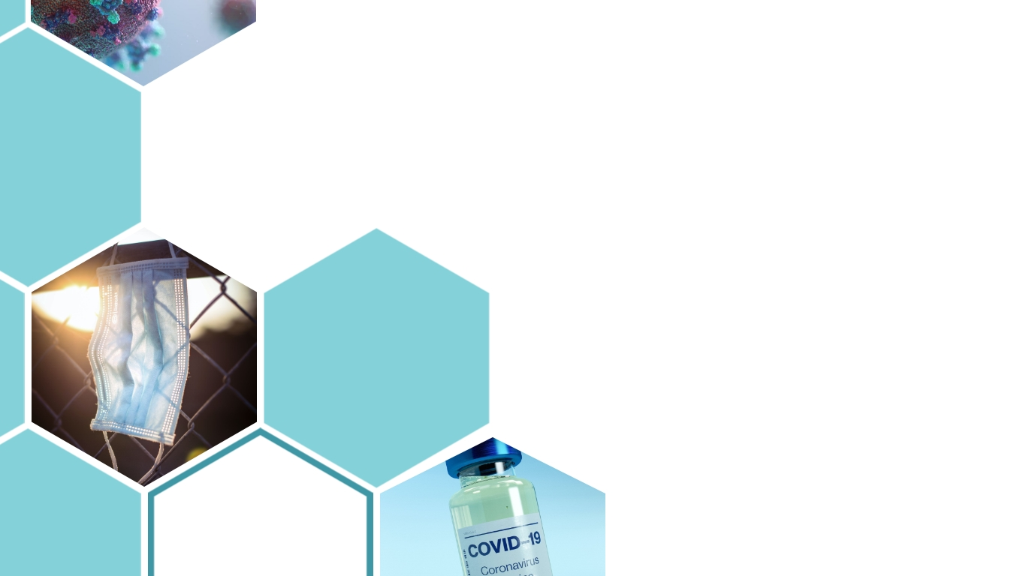
SLO 1.1 : Application of engineering knowledge
SLO 3.5 : Detail Design
SLO 3.6 : Production Planning
SLO 3.7 : Documentation
SLO 4.6 : Synthesis of conducted experiments
SLO 5.2 : Selection/Creation
SLO 5.3 : Application of appropriate techniques
SLO 5.4 : Verification and improvement
SLO 5.5 : Analysis and synthesis of information obtained
SLO 8.1 : Ethics
SLO 9.1 : Individual and team work
SLO 11.2 : Time Management
SLO 11.3 : Cost Management
SLO 11.4 : Quality Management
SLO 11.5 : Human Resource Management
SLO 11.6 : Communication Management
SLO 12.2 : Acquiring Knowledge
SLO 12.3 : Applying Knowledge
SLO 12.4 : Reflect and Teach
CONTENTS

Slide 3

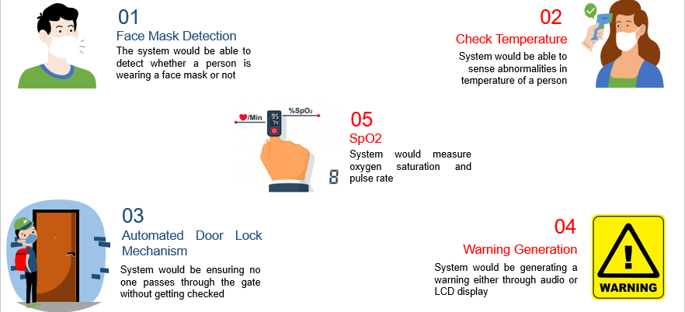
SLO 1.1: Application of engineering knowledge

Slide 4
SLO 3.5: Detailed Design
Logi Camera 720p
Audio Generator
MLX90614 Temperature Sensor
Atech Camera 1080p
Nvidia Jetson Nano
MAX30102 SpO2 Sensor
Arduino Uno
H Bridge Driver Circuit
12V Fan
Electronic Door Lock

Slide 5
SLO 3.6: Production planning
The system was designed specifically for the client but for introducing it to the market the following changes can be made to make it cost effective and suitable for manufacture.
We can use embedded microcontroller for running algorithms instead of expensive NVidia jetson nano
Instead of a Monitor for display, an LCD can be embedded into the product to save space and make the product portable.
Redesigning the shape of product to make it much compact and less expensive
When manufactured in bulk the estimated cost would be nearly Rs. 45000-50000 each

Slide 6
SLO 4.6: Synthesis of conducted experiment
Conclusions:
Face Mask Detection model has been successfully tested and is 94% accurate.
Social Distancing is being checked for upto max 3 people with distance range of half a meter.
Temperature sensing, spo2 sensing and door lock has been successfully tested using Arduino.
Limitations:
There is a delay in SpO2 value display for 5 second since it takes average of 10 values.
There are better sensors for SpO2 and Temperature but it is out of our budget.

Slide 7
SLO 5.2: Selection and Creation
Social Distancing Detection
There were different pre-trained models and techniques and the ones that were tested were YOLO, MobileNet v2, Haar Cascade, Transfer Learning. However, MobileNet v2 was the most effective and most accurate.
Camera Selection
There were several cameras, such as CSI cameras of Raspberry Pi Cameras however we used USB camera since it has a bigger range, higher FPS and more resolution.
Microcontroller Selection:
Nvidia Jetson Nano was selected rather than Raspberry Pi 3B+ since Jetson Nano has a build in GPU which provides us more FPS and can run 4 Neural Networks in parallel. We required to run 2 Neural Networks in parallel and 1 other process as well.

Slide 8
SLO 5.3: Application
The system can be install on entrances of public places
Schools
Industries
Stadium
Hotel
Can be used to monitor and enforce the SOP following in public places
System can be also modified to monitor different restrictions in places such as operation theaters, nuclear installations and mining areas.
Since the models are trained, this product with some modifications can be used for other applications such as Intruder Detection, Jaywalking Detection.

Slide 9
SLO 5.4: Verification and Improvements
Verification:
The designed system is tested in lab on various person with success in each objective
The Models was tested on a video with several case scenarios and in real time.
Improvement:
The improvement can be made in Machine learning model because in noisy environment it accuracy decreases
We can used the depth sensing camera for further improve the output of our system
Arduino can be replaced by itself jetson nano
Waiting Time can be reduce by using different spo2 sensor
Internet of things can be used for image transfer and record

Slide 10
SLO 5.5: Analysis and Synthesis
The system is only able to monitor social distancing in first 3 person and with distance range half a meter.
A wireless camera could be used to tackle this.
The person has to press his finger tightly on the SpO2 sensor for accurate readings.

Slide 11
SLO 8.1 :Ethics
Work ethics were followed when communicating with each other
Code of conduct was kept in mind when working in project lab
Lab resources were utilized only for project and would be returned after its completion
Meetings were properly scheduled with the clients to avoid any inconveniences

Slide 12
SLO 11.2: Time management
An Automated COVID-19 SOPs Monitoring And Management System
1.1
Face Mask Detection
1.2
Forehead Temperature Measurement
1.4
Social Distancing
1.1.1.1
Research on Image Processing and ML Algorithms
1.1.1
Software Research
1.1.2
Hardware
1.1.2.1
Research on Different Hardware Required
1.1.2.2
Selection of Best Hardware
1.2.2
Hardware
1.2.2.1
Research on Different Measurements
1.2.2.2
Selection of Hardware
1.1.1.3
Selection of Best Algorithm based on performance
1.1.1.4
Testing the Selected Algorithm using Laptop and Camera
1.4.1
Software Research
1.4.2
Hardware
1.4.1.1
Research Different Algorithms
1.1.1.2
Installing Required Packages
1.4.1.2
Testing Different Algorithms using Laptop and Webcam
1.4.1.3
Selection of Best Algorithm based on performance
1.4.1.4
Testing the Selected Algorithm using Laptop
1.4.2.1
Research on Different Hardware Required
1.4.2.2
Selection of Best Hardware
1.3
Automated Door Lock Mechanism
1.3.1
Software
1.3.1.1
Writing Code for Locking and Unlocking
1.3.2
Hardware
1.3.2.1
Research on Different Electric Door Locks Available
1.3.2.2
Select Best Hardware
1.3.2.3
Purchase Selected Hardware
1.3.2.4
Test the code using Laptop and Purchased Hardware
1.2.1
Software
1.2.1.1
Writing Code

Slide 13
SLO 11.3: Cost Management
No. | Component | Cost (Rs.)
1 | Nvidia Jetson Nano | 33000
2 | Arduino Uno | 1250
3 | MLX90614 Temperature Sensor | 2200
4 | MAX30102 Oximeter | 350
5 | USB Camera Logitech | 3500
6 | USB Camera A4tech | 4000
7 | HC-SR04 Ultrasonic Sensor | 150
10 | Power Adaptor 5V | 350
11 | Micro SD card 64 GB | 1200
12 | L298 Motor Driver | 300
 | Total Cost = Rs. 46,300

Slide 14
SLO 11.4: Quality Management
To ensure best output from each module proper research was done for each hardware and software component
Product efficiency was ensured by conducting experiment at different room temperatures
Inbuilt system for ventilation was created to avoid overheating of microcontrollers
Each sensor was tested before integrating it in the complete prototype

Slide 15
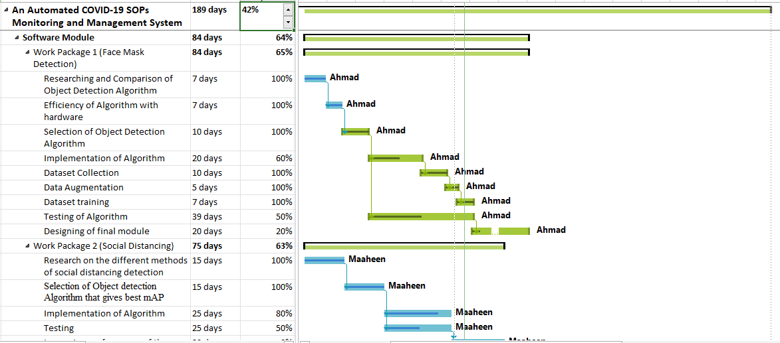
SLO 11.5 & 9.1: Human Resource Management & Working Effectively

Slide 16
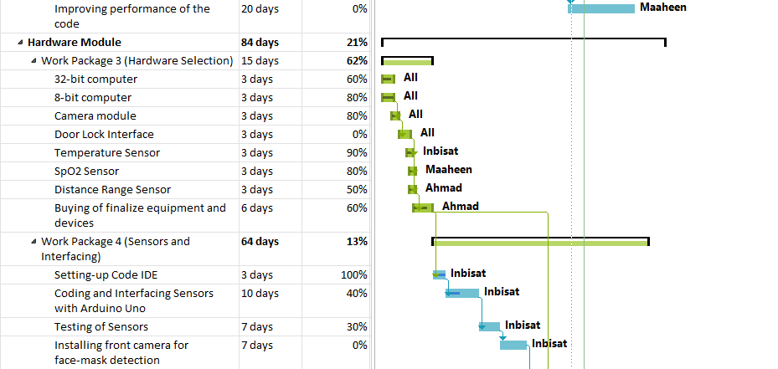

Slide 17
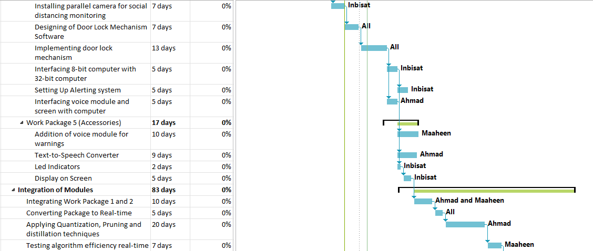
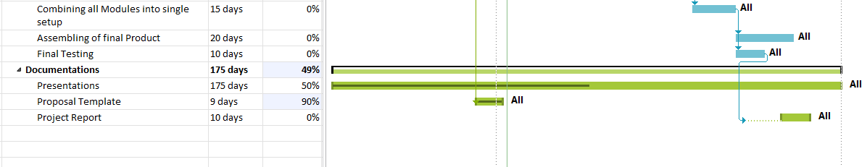

Slide 18
SLO 11.6 : Communication Management
Within the team, communication was done through different channels like emails and in person meetings
Before each presentation, the content was divided and documented
In order to resolve issues, issues by each member were enlisted on excel sheet
Each weeks work was scheduled and the achievements were then documented
Finals report was prepared by providing all timelines of meetings with team members and client
Each member’s opinion and say was valued and written down prior to starting work on a module

Slide 19
SLO 12.2 & 12.3: Acquire and Apply
We learned a lot about artificial intelligence and deep learning, which extensively used in our product
We also learn and apply different machine learning algorithms such as CNNs, and Mobilenet
We learned how to used OpenCV for Image Processing
We researched about different hardware devices and after comparison select the best match for our system
We also learn how to used and program embedded system such as Nvidia Jetson Nano, Raspberry Pi and Arduino
Gain knowledge about interfacing and programming sensors

Slide 20
SLO 12.4: Reflect and Teach
Initially we used OpenCV for machine learning but soon realizes that the algorithm it provides are not suitable for our system.
Also using low quality memory card cost us 1 week our progress delay because it was easily corrupted.
We can retrain the system with more images and noisy environment to make it more accurate
Bounding box regression experiment failure
We also spend a lot of time on implementing the system on raspberry pi but it does not work forcing us to switch system to Jetson Nano

Slide 21


